Slide 1

WEB DESIGN TRAINING

Slide 2

INTRODUCTION TO CSS

Slide 3

ICEBREAKER
Describe Your Partner

Slide 4

WHAT IS CSS?
Cascading Style Sheets (CSS) define the look and feel of HTML elements in a Web page.

Slide 5


IN THIS SESSION
What is a Cascading Style Sheet (CSS)?
What are the benefits of a CSS?
How to define a CSS?
What are the different types of style sheets?

Slide 6

ASSUMPTIONS
You have an understanding of HTML.

Slide 7

REQUIREMENTS
Personal Computer (Obviously!)

Slide 8

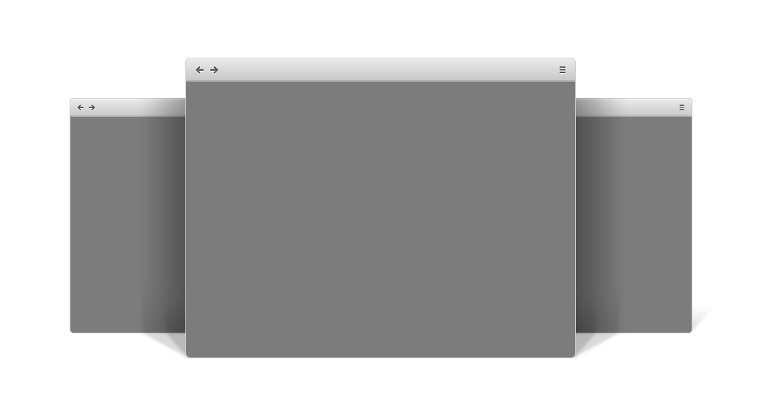
REQUIREMENTS
Web browser (Mozilla Firefox, Microsoft Internet Explorer, Chrome, or Opera)

Slide 9
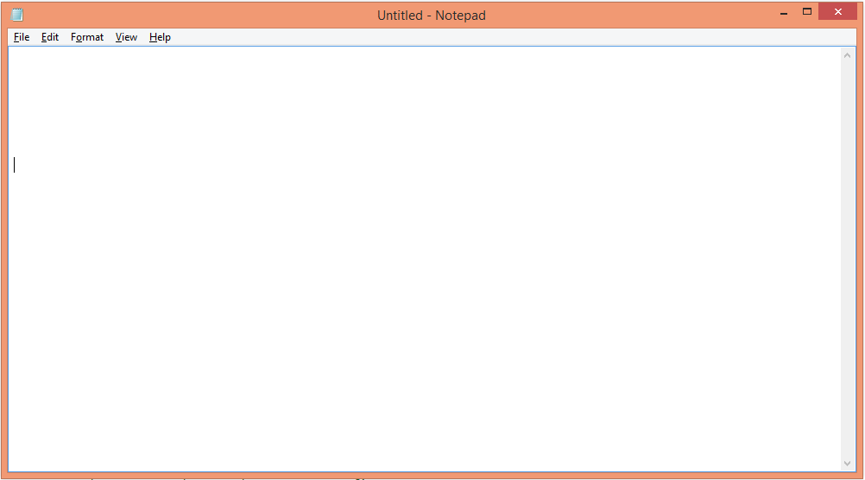
REQUIREMENTS
Word processor (Windows "Notepad" or "WordPad" programs or the MAC "Simple Text" program)

Slide 10

FREQUENTLY ASKED QUESTIONS
FAQs
Q. Do I need to know HTML to understand the concept of CSS?
A. Yes. It is essential to have a working knowledge of HTML to be able to write instructions/rules for a CSS.
Q. Must I be logged onto the Internet to do this? Will learning this increase my Internet usage cost?
A. Neither. You will write/work offline.
Q. Do I need some sort of expensive program to help me write this?
A. No. You will write using Notepad or WordPad.

Slide 11
DEFINING STYLES

Slide 12




INTRODUCTION
Why Use CSS ?
1
Styles are added to HTML to solve different issues
2
External Style Sheets are stored in CSS files
3
Saves a lot of work

Slide 13
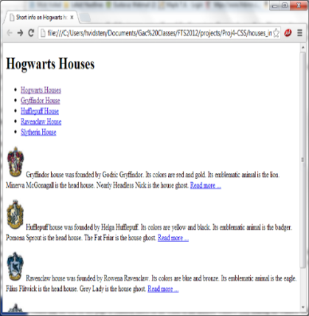

INTRODUCTION
Example: A Web Page without CSS
Example: A Web Page with CSS

Slide 14
WHY DEFINE CSS?
One file does all
Easy maintenance
Reduction in the size of webpage file
Faster downloading and rendering of webpages

Slide 15
CSS SYNTAX
A CSS rule or style has two parts:
1
Selector
3
Example:
Property: Value Pair (Declaration)
td {width : 36px; }
Rule
selector { property( ): value; }
EXAMPLES
Declaration
p {color: blue; text-align: left;}
h1 {color: black; font-size: 14px;}
p {background-color: #e0ffff; font-family: Times New Roman;}

Slide 16
INTRODUCTION
SELECTORS
Selectors are basic patterns that help you style your sheet.
We have various selectors to implement the rules but the most common are class and id selectors.
FOR A CLASS =“intro”:
FOR styling element id = “name”:
.intro { background-color: yellow; }
#name { background-color: yellow; }
Image reflecting following code Output
Image reflecting following code Output

Slide 17
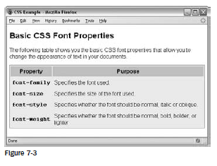
INTRODUCTION
Example: A Web Page with CSS
Write code to create a similar web page as shown in the image using CSS sheet code.

Slide 18
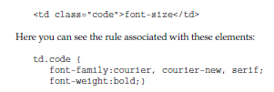
INTRODUCTION
INHERITANCE
CSS properties that are set on an element through the cascade, can be inherited by the child elements of that element. For instance, if a div element has font-size 30px then, assuming that none of the font-size declarations have been explicitly defined, a children will inherit that font-size value.
Where to add CSS Rules
Inside a < style > element, which sits inside the < head > element of a document
As a value of a style attribute on any element that can carry the style attribute

Slide 19
CSS PROPERTIES
Text
Font
Background
Padding
Border
List
Links
Table

Slide 20





CSS PROPERTIES
TEXT PROPERTIES
The various text formatting properties that can be applied using CSS are:
Color
Alignment
Decoration
Transformation
Indentation

Slide 21
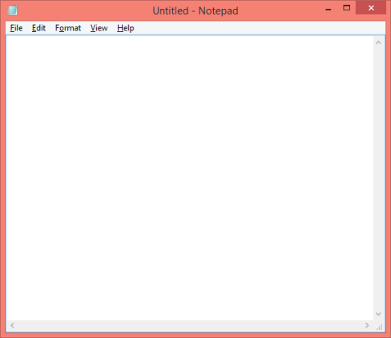
CSS PROPERTIES
TEXT PROPERTIES
The various text formatting properties that can be applied using CSS are:
body { color: black; } h1 { color: #00ff00; } h2 { color: grey;
}
Color
Alignment
Decoration
Transformation
Indentation

Slide 22
CSS PROPERTIES
TEXT PROPERTIES
The various text formatting properties that can be applied using CSS are:
h1 {
text-align: center;
}
h2 {
text-align: left;
}
p {
text-align: justify;
}
Color
Alignment
Decoration
Transformation
Indentation

Slide 23
CSS PROPERTIES
TEXT PROPERTIES
The various text formatting properties that can be applied using CSS are:
a { text-decoration: none; }
Color
Alignment
Decoration
Transformation
Indentation
h1 { text-decoration: overline; } h2 { text-decoration: underline; } h3 { text-decoration: line-through; }

Slide 24
CSS PROPERTIES
TEXT PROPERTIES
The various text formatting properties that can be applied using CSS are:
p.uppercase { text-transform: uppercase; } p.lowercase { text-transform: lowercase; } p.capitalize { text-transform: capitalize; }
Color
Alignment
Decoration
Transformation
Indentation

Slide 25
CSS PROPERTIES
TEXT PROPERTIES
The various text formatting properties that can be applied using CSS are:
Color
Alignment
Decoration
Transformation
Indentation
p { text-indent: 100px; }

Slide 26
CSS PROPERTIES
Text
Font
Background
Padding
Border
List
Links
Table

Slide 27

CSS PROPERTIES
FONT PROPERTIES
1
Font Family
2
Font Style
3
Font Size
4
Font Weight

Slide 28
CSS PROPERTIES
FONT PROPERTIES
1
Font Family
p { font-family: Arial;
}
2
Font Style
Put the name of font in quotation marks if it is more than one word long.
3
Font Size
4
Font Weight

Slide 29
CSS PROPERTIES
FONT PROPERTIES
1
Font Family
p.normal { font-style: normal; } p.italic { font-style: italic; }
2
Font Style
3
Font Size
4
Font Weight

Slide 30
CSS PROPERTIES
FONT PROPERTIES
1
Font Family
h1 { font-size: 50px; } h2 { font-size: 25px; } p { font-size: 15px; }
2
Font Style
3
Font Size
4
Font Weight

Slide 31
CSS PROPERTIES
FONT PROPERTIES
1
Font Family
p.normal {
font-weight: normal;
}
p.thick {
font-weight: bold;
}
2
Font Style
3
Font Size
4
Font Weight

Slide 32
CSS PROPERTIES
Text
Font
Background
Padding
Border
List
Links
Table

Slide 33
CSS PROPERTIES
BACKGROUND PROPERTIES
Background
Color
Background
Image
body { background-color: blue; }
h1 { background-color: # e0ffff; } p { background-color: grey; }
body { background-image: url(“dots.gif"); background-repeat: repeat-y; }
body { background-image: url(“sun.gif"); background-repeat: no-repeat; background-position: center; background-attachment: fixed
}

Slide 34
CSS PROPERTIES
Text
Font
Background
Padding
Border
List
Links
Table

Slide 35
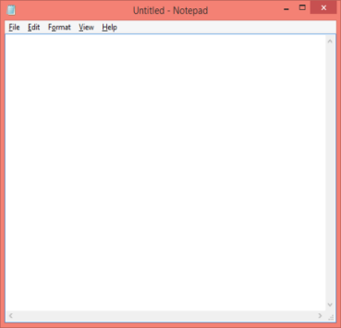
CSS PROPERTIES
PADDING PROPERTIES
p { padding-top: 20px; padding-bottom: 20px; padding-left: 15px; padding-right: 15px; }
You can set different padding values for different sides.

Slide 36
CSS PROPERTIES
Text
Font
Background
Padding
Border
List
Links
Table

Slide 37
CSS PROPERTIES
BORDER PROPERTIES
p { border-color: red; border-style: dashed; border-width: 15px; }

Slide 38
CSS PROPERTIES
Text
Font
Background
Padding
Border
List
Links
Table

Slide 39
CSS PROPERTIES
LIST PROPERTIES
ol { list-style-type: uper-latin; }
Ordered Lists (<ol>)
Marked with numbers or alphabets
ul{ list-style-type: circle; }
upper-latin = A, B, C
lower-latin = a, b, c
upper-roman = I, II, III lower-roman = I, ii, iii
decimal = 1, 2, 3
Unordered Lists
(<ul>)
Marked with bullets

Slide 40
CSS PROPERTIES
Text
Font
Background
Padding
Border
List
Links
Table

Slide 41
CSS PROPERTIES
LIST PROPERTIES
Type of Link | Code
Unvisited | a:link
Visited | a:visited
Final Project | a:hover
Just Clicked | a:active
/* unvisited link */ a:link { color: blue; } /* visited link */ a:visited { color: green;
}

Slide 42
CSS PROPERTIES
Text
Font
Background
Padding
Border
List
Links
Table

Slide 43
CSS PROPERTIES
TABLE PROPERTIES
Property Purpose
border - collapse Where the borders of two table cells touch, this property determines whether both the borders should be visible, or the browser should pick one of the borders to display.
table.one {border-collapse:collapse;}
table.two {border-collapse:separate;}
td.a {border-style:dotted; border-width:3px; border-color:#000000;
padding:10px;}
td.b {border-style:solid; border-width:3px; border-color:#333333;
padding:10px;}

Slide 44
CSS PROPERTIES
TABLE PROPERTIES
border
{border-spacing:15px;}
Spacing specifies the width of space, which should appear between table cells
{caption-side:bottom}
caption
Side specifies the side of a table at which caption should appear i.e. top, bottom, right or left.

Slide 45

CSS PROPERTIES
Points to consider
Before you start designing the layout, consider the following things:
Understand the site’s aim correctly and gather information required to fulfill those objectives
Group the information into “elements” (such as navigation, logos, contact information, product information, and so on)
Create a site map, which shows the number of required pages
Decide how to position various elements within the page
How to use CSS for positioning the elements on the page
Develop for mobile phones

Slide 46
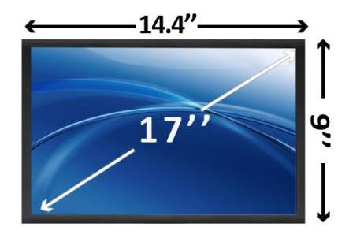
PAGE LAYOUT
Page Size and Screen Resolution
However, different visitors may be visiting your site through distinct devices with varying screen sizes. Therefore, make sure that it is flexible enough to adapt itself to different screens.
Responsive or liquid design concept can be a good solution in such cases. While designing a liquid layout, we specify the proportion of our page in percentage values.
This means that the screen is 1024 pixels wide and 768 pixels high.
Size of a 17 inch screen

Slide 47

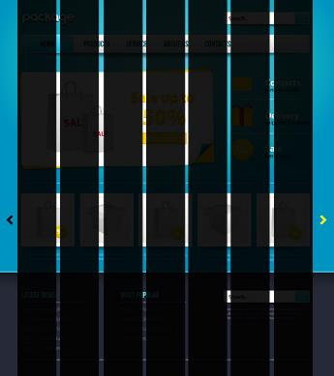
PAGE LAYOUT
Designing Pages
Composition and Grids
It is a visual art , which deals with the arrangement & placement of visual elements.
These Gray Lines are called Grids and every other thing are elements.

Slide 48

PAGE LAYOUT
Grid
A grid helps you place the elements in single column.

Slide 49
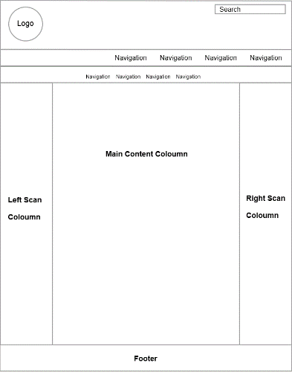
PAGE LAYOUT
Sketching position of an element on grid
In this image, you build a sketch of areas according to the position and size of your page element.
Whether it is an image or text, this gives a structure to your page as per your requirement.

Slide 50
PAGE LAYOUT
Coding Your Page
Use the following elements to code the structure if your site:
1
XHTML<div> element to group your page elements
2
CSS float property to position the <div> elements
3
CSS width property to set the width of boxes
4
CSS margin property to separate the blocks from each other
Notes:
Notes to GD: Please create these images again.

Slide 51
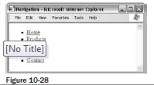
NAVINGATION IN CSS
Navigation Elements
Elements | Property | Coding | Output Image
Menus | Menus should be concise. Menus should have clear labels. Menus should focus on what visitors want to achieve. | < ul id=”navigation” > < li > < a href=”/” > Home < /a > < /li > < li > < a href=”/products/” > Products < /a > < /li > < li > < a href=”/services/” > Services < /a > < /li > < li > < a href=”/about/” > About < /a > < /li > < li > < a href=”/contact/” > Contact < /a > < /li > < /ul >

Slide 52
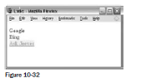
NAVINGATION IN CSS
Navigation Elements
Elements | Property | Coding | Output Image
Links | Two types of links Text links and Images as links | Text Link : a {font-weight:bold; color:#ff0000; text-decoration:none;} a:hover {color:#FF9900; text-decoration:underline; background-color:#f9f0f0;} a:visited {color:#990000;} Image as Link: alt = ” description of image or text on image ” title= ” where the link will take the user ”

Slide 53


NAVINGATION IN CSS
Navigation Elements
Elements | Property | Coding | Output Image
Search of relevant information ( search box) | This feature makes your site more usable. | < form method=”get” action=”http://www.google.com/search” > < input type=”text” name=”q” size=”31” maxlength=”255” value=”” / > < input type=”submit” value=”Search” / > < input type=”radio” name=”sitesearch” value=”wrox.com” / > < /form >

Slide 54
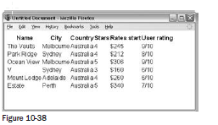
DESIGN CONSIDERATIONS
Tables
Techniques that make your tables a lot easier for users to read:
1
Padding
2
Headings
3
Shading columns
th, td {padding:10px 20px 8px 10px;}
Notes:
Notes to GD: Please create these images again.

Slide 55
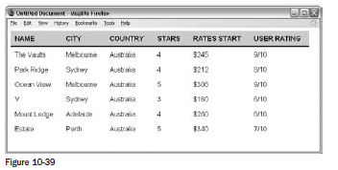
DESIGN CONSIDERATIONS
All the table headings must be in bold, which is the default style for < th > element.
th {
border-bottom:2px solid #000000;
text-transform:uppercase;
background-color:#d6d6d6;
text-align:left;}

Slide 56
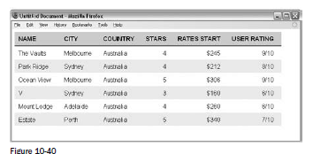
DESIGN CONSIDERATIONS
Shading alternate rows will help users follow along the lines.
If we put all of that together, the CSS for table you have been looking at is as follows:
th, td {
padding:8px 20px 8px 10px;
margin:0px;}
th {
border-bottom:2px solid #000000;
text-transform:uppercase;background-color:#d6d6d6;
text-align:left;}
.even{background-color:#efefef;}
.number {text-align:right;}

Slide 57

DESIGN CONSIDERATIONS
Forms
List of the information needed for registration form:
Login information
User ’ s name
User ’ s address
User ’ s contact details
Once this is done, the required information is:
Login information: Username and password
Name: First name, last name
Land address: Street address, city, zip code
Contact information: E - mail address, area code, phone number

Slide 58
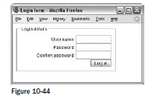
DESIGN CONSIDERATIONS
Using < fieldset > Elements
For example, here is a form for a user to enter login details ( ch10_eg17.html ):
< form name=”frmLogin” action=”login.aspx” method=”post” >
< fieldset >
< legend > Login < /legend >
User name: < input type=”text” size=”12” name=”txtUserName” / > < br / >
Password: < input type=”password” size=”12” name=”txtPassword” / > < br / >
Confirm password: < input type=”password” size=”12”
name=”txtPasswordConfirmed” / > < br / >
< input type=”submit” value=”Log in” / >
< /fieldset >
< /form >

Slide 59
DISCUSSION
A Site Registration Form
Information | Form Control | Required
First Name | Text Input | Yes
Last Name | Text Input | Yes
E-Mail address | Text Input | Yes
Password for accessing the site | Password text input | Yes
Conformation Of password | Password text input | Yes
Register | Submit button | No
List the elements to create a site registration Form.

Slide 60

CREATING A STYLE SHEET
Steps to create a CSS:
Open a text editor (SimpleText for Mac or Notepad for Windows). Enter the following text:
<html>
<head>
<style>
body {background-color: #F0F8FF;} h1 {color: blue; text-align: center; font-size: 40px; font-weight: bold; font-family: Arial;} p {text-align: left; font-family: "Times New Roman"; font-size: 20px} </style> </head> <body> <h1>My First CSS</h1> <p>Hello everyone! This is my first CSS and there is more to come...</p> </body> </html>
2. Save the document as: myfirstcss.html
3. Preview your new CSS using any browser.

Slide 61
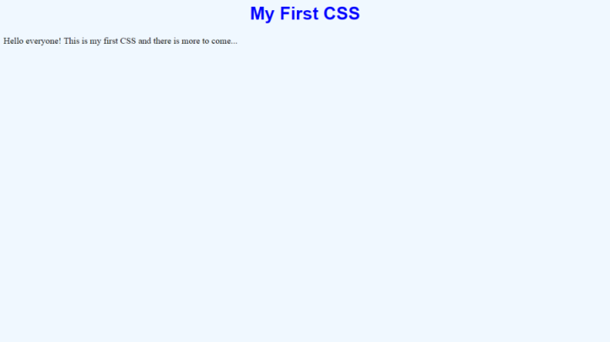
CREATING A STYLE SHEET

Slide 62


TYPES OF STYLE SHEETS
1
Inline CSS
2
Internal CSS
3
External CSS

Slide 63
POINTS TO REMEMBER
Inline CSS | Internal CSS | External CSS
Used to apply a unique style to selective elements | Used to apply a unique style on a specific page | Used to apply a selected style on all the pages
Cascading
Order
The external style sheet will override the internal style sheet if its link is placed below the internal style sheet in HTML <head>.
Inline style
Internal style
External style

Slide 64

USING INLINE CSS

Slide 65


POINTS TO REMEMBER
Inline style is used to apply a unique style on an element.
Use it sparingly!

Slide 66
HOW TO USE AN INLINE STYLE?
To use an inline style:
Add the style attribute to the relevant tag
This is the heading text.
<h1 style="color:blue;margin-left:20px;">Tips to Prevent Heat Stroke</h1>
<h1 style=" background:grey;color:blue;margin-left:20px;">Tips to Prevent Heat Stroke </h1>

Slide 67
USING INTERNAL CSS

Slide 68

WHAT IS AN INTERNAL CSS?
An internal style sheet is used to apply a unique style to a single page

Slide 69
HOW TO USE AN INTERNAL CSS?
To use an internal style sheet:
Define it within the <style> element, inside the head section of HTML page
<head> <style> body { background-color: white; } h1 { color: blue; align-text: center; font-weight: bold } </style> </head>

Slide 70
USING EXTERNAL CSS

Slide 71

WHAT IS AN EXTERNAL CSS?
An external style sheet maintains CSS and HTML separately.

Slide 72

WHAT IS AN EXTERNAL CSS?
Why is it important to maintain both CSS and HTML separately?

Slide 73
HOW TO USE AN EXTERNAL CSS?
<head> <title><title> <link rel=”stylesheet” type=”text/css”href=”<name of your style sheet>”.css /> </head> <body>
You can reference the external style sheet in your HTML using the <link> element.
To use an external CSS, simply place the <link> element inside the head section.
myfirstcss

Slide 74

Thank you!
Contact us today to discuss your requirements.
609-606-9020
What is next?
Discuss current challenges
Let us show you what we can do

